Slide 1
Combined tagging data
Collated all available tagging data
Includes both conventional and satellite tags (using only release/pop-off locations)
Starts in 1982, total of 2,879 tags
Filter to:
At least 30 days at liberty
Released-recovered in EBS|NBS, WGOA, and CGOA
 | Release region
 | EBS|NBS | WGOA | CGOA
Pre-2020 | 2,051 | 132 | 453
Post-2020 | 37 | 139 | 67
Total | 2,088 | 271 | 520

Slide 2
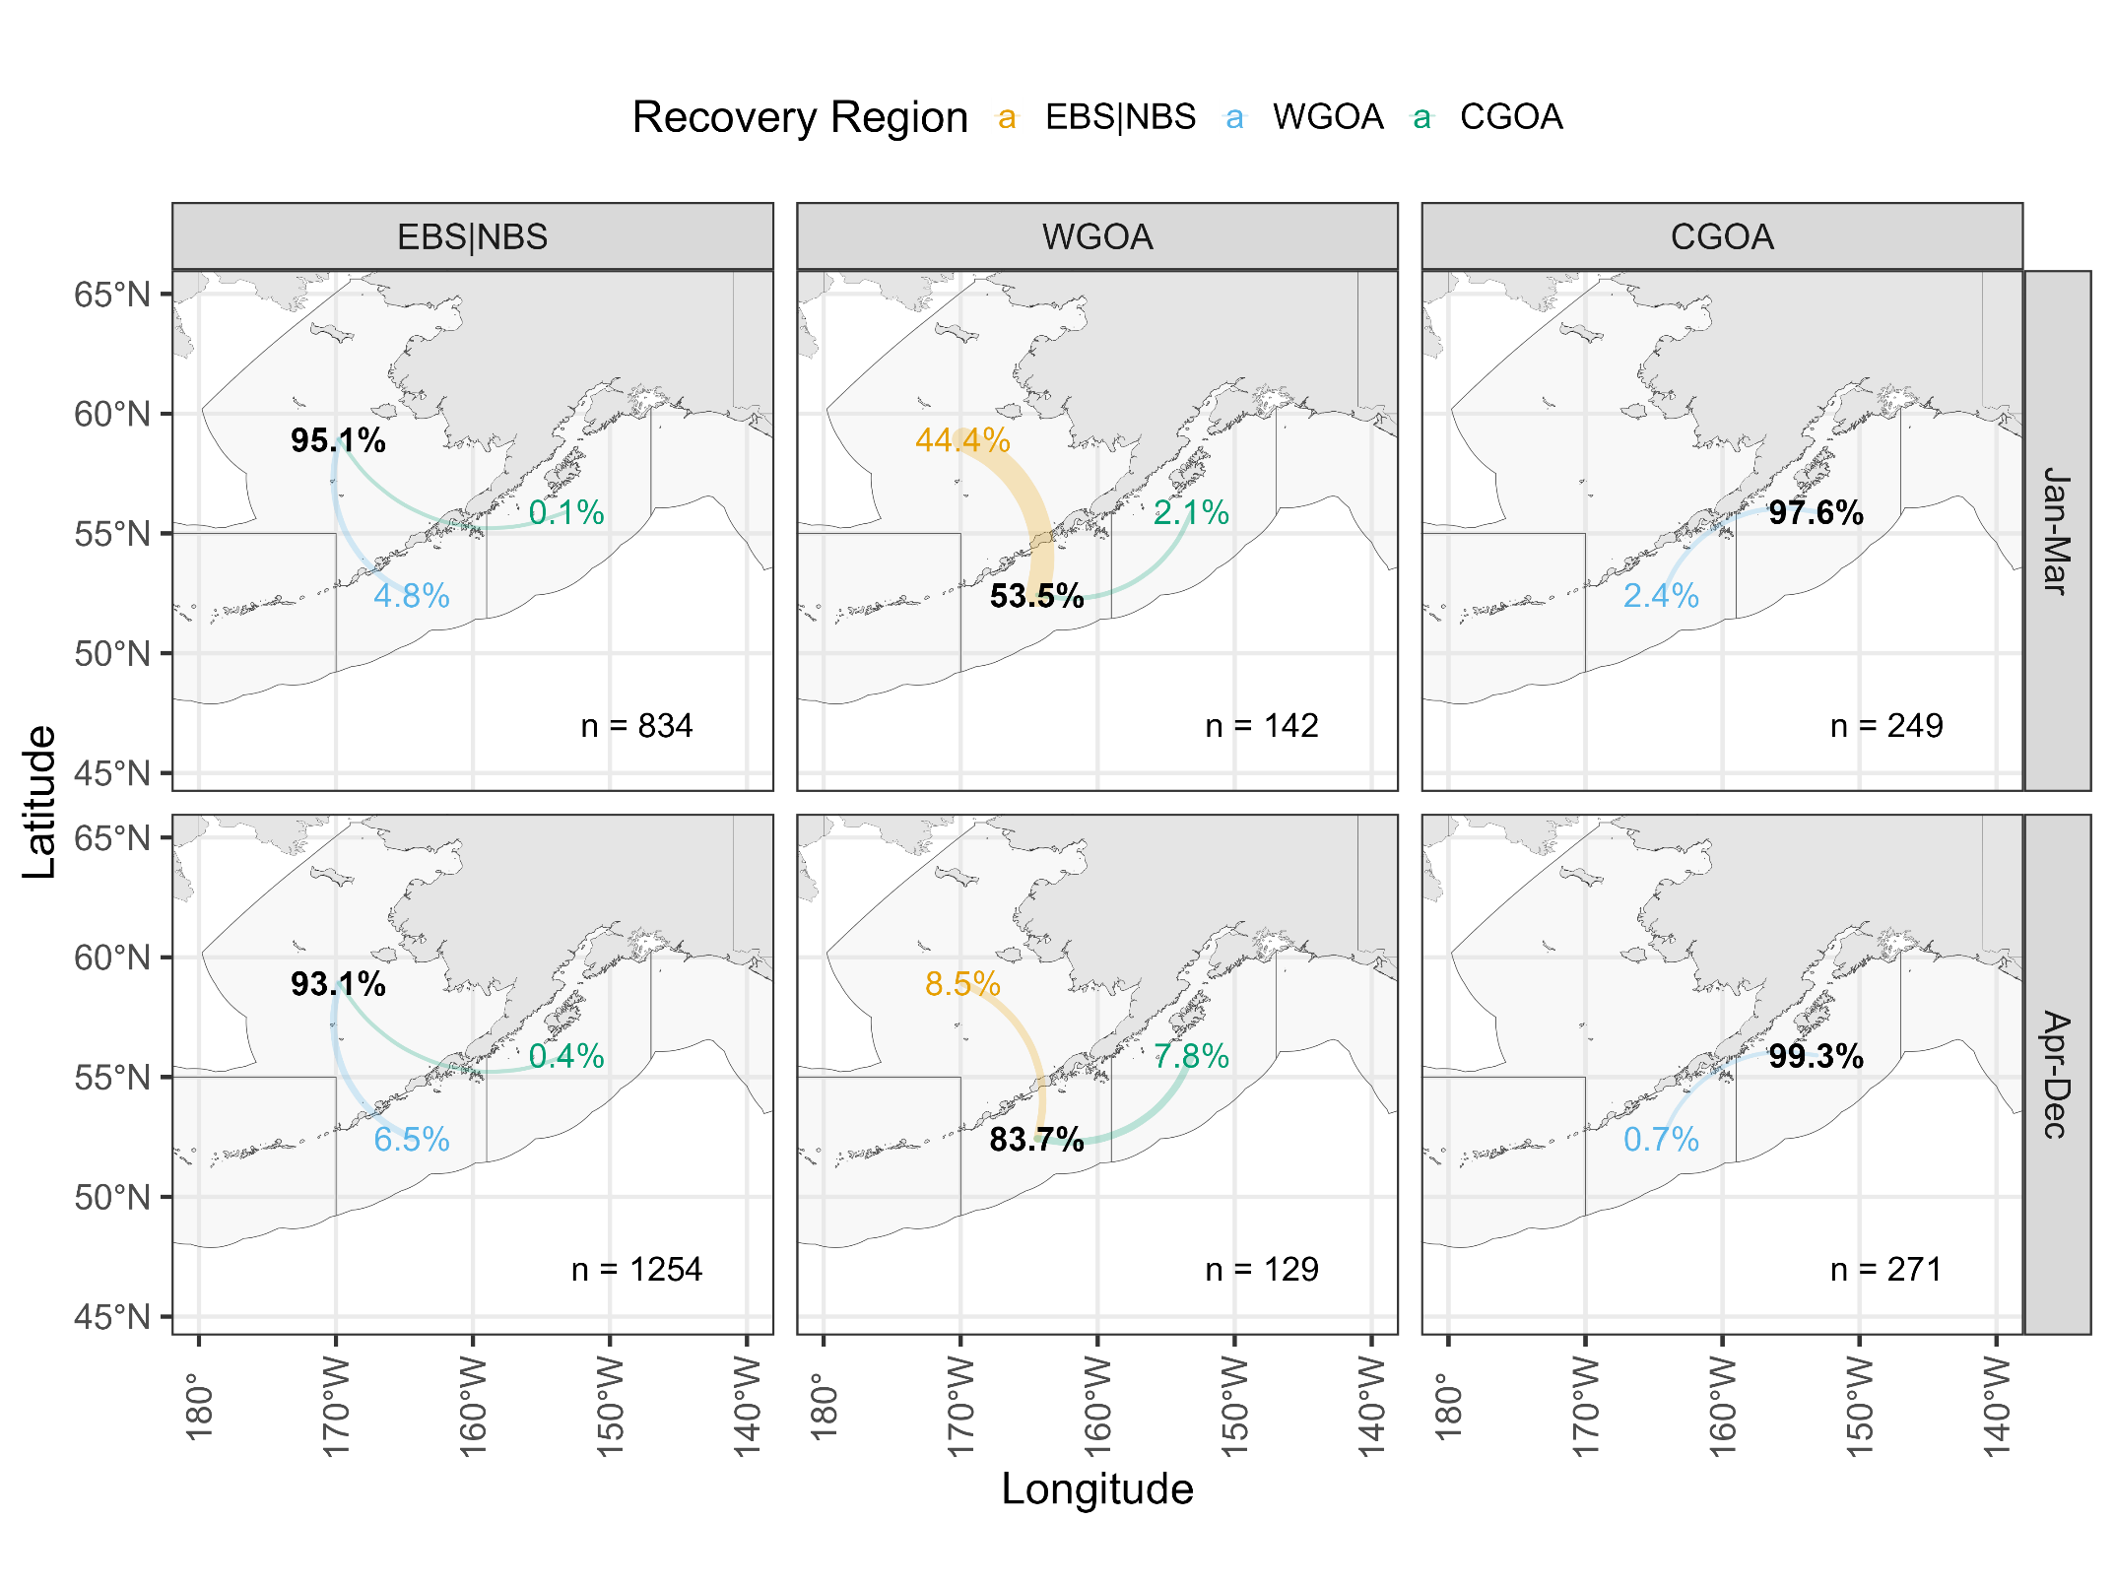

Slide 3
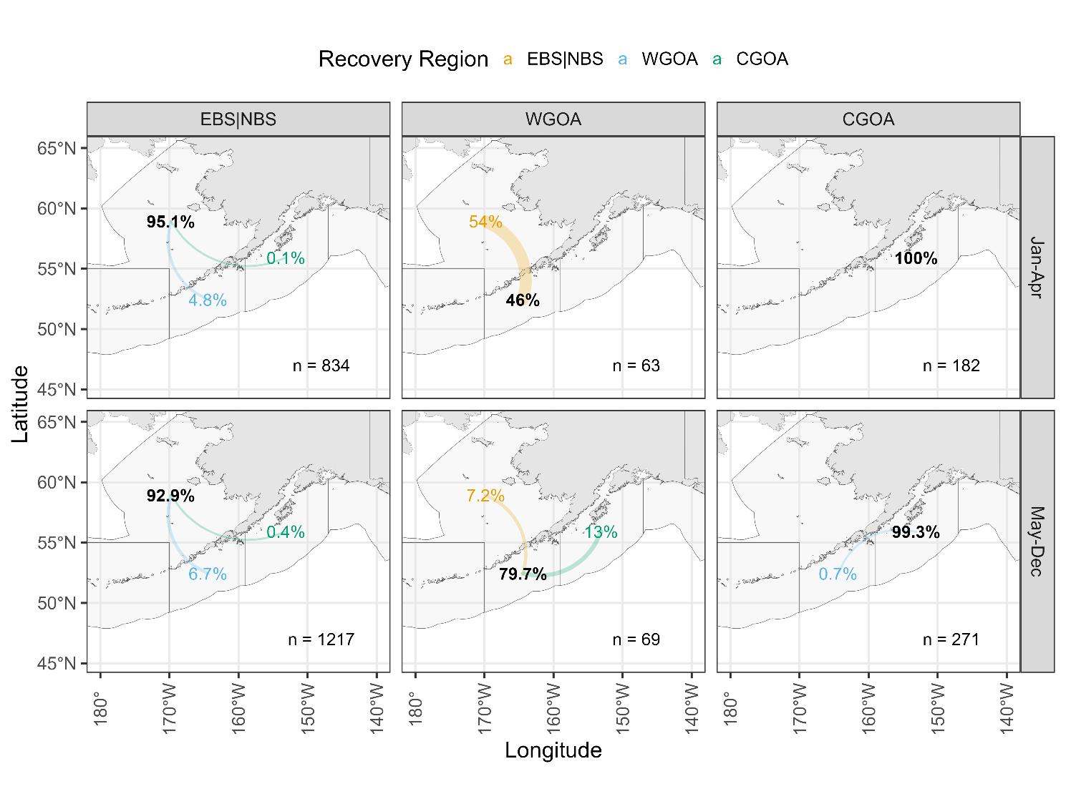
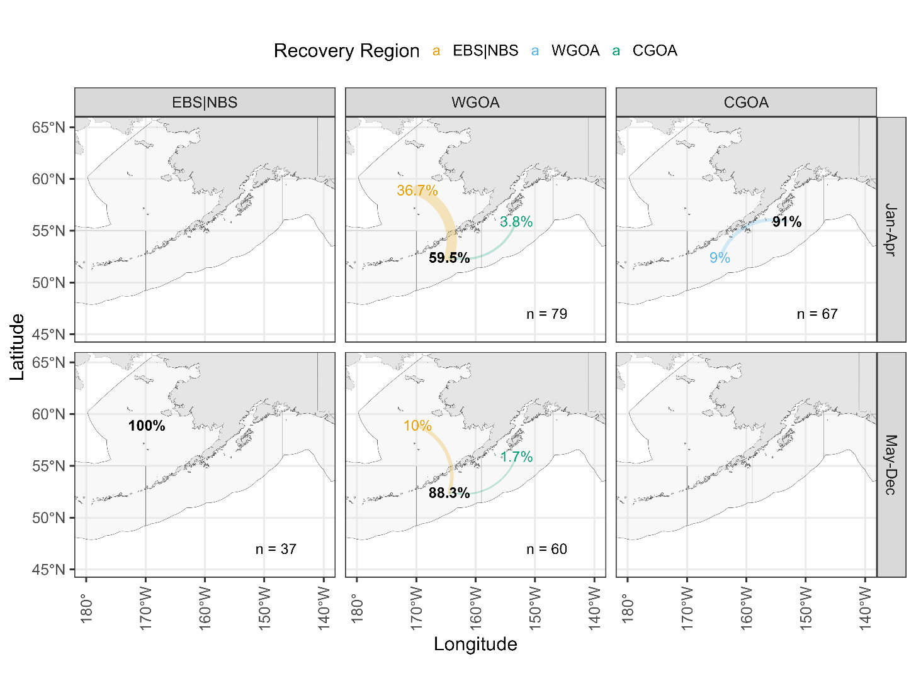
Pre-2020
Post-2020

Slide 4
Combined tagging data
Why Jan-Mar? Seasonality of movement from WGOA:
 | From WGOA, to…
Month | EBS|NBS | WGOA | CGOA | n
1 | 33% | 67% | 0% | 42
3 | 49% | 48% | 3% | 100
4 | 12% | 86% | 2% | 50
5 | 0% | 100% | 0% | 3
6 | 0% | 100% | 0% | 2
7 | 4% | 96% | 0% | 23
8 | 9% | 73% | 18% | 45
9 | 0% | 83% | 17% | 6
All | 27% | 68% | 5% | 271

Slide 5
Combined tagging data
Seasonality of movement from EBS|NBS:
 | From EBS|NBS, to…
Month | EBS|NBS | WGOA | CGOA | n
1 | 84% | 16% | 0.0% | 19
2 | 95% | 5% | 0.1% | 809
3 | 100% | 0% | 0.0% | 6
4 | 94% | 6% | 0.0% | 678
6 | 90% | 7% | 2.8% | 71
7 | 96% | 4% | 0.0% | 82
8 | 94% | 6% | 0.0% | 108
9 | 94% | 6% | 0.7% | 141
10 | 84% | 12% | 4.0% | 25
11 | 90% | 9% | 0.7% | 149
All | 94% | 6% | 0.3% | 2088

Slide 6
Combined tagging data
Take homes:
WGOA has largest amount of movement out of the region as compared to EBS|NBS and CGOA
Strong seasonal component, bulk of movement from WGOA to EBS|NBS occurs prior to April
Recent tagging has less movement to EBS|NBS (~37%) as compared to historical tagging data (~54%) prior to April
EBS|NBS movement to WGOA consistent across month/season, and hovers ~6%
CGOA has limited movement to WGOA, none to EBS|BS

